Slide 1
Flight from

Slide 2
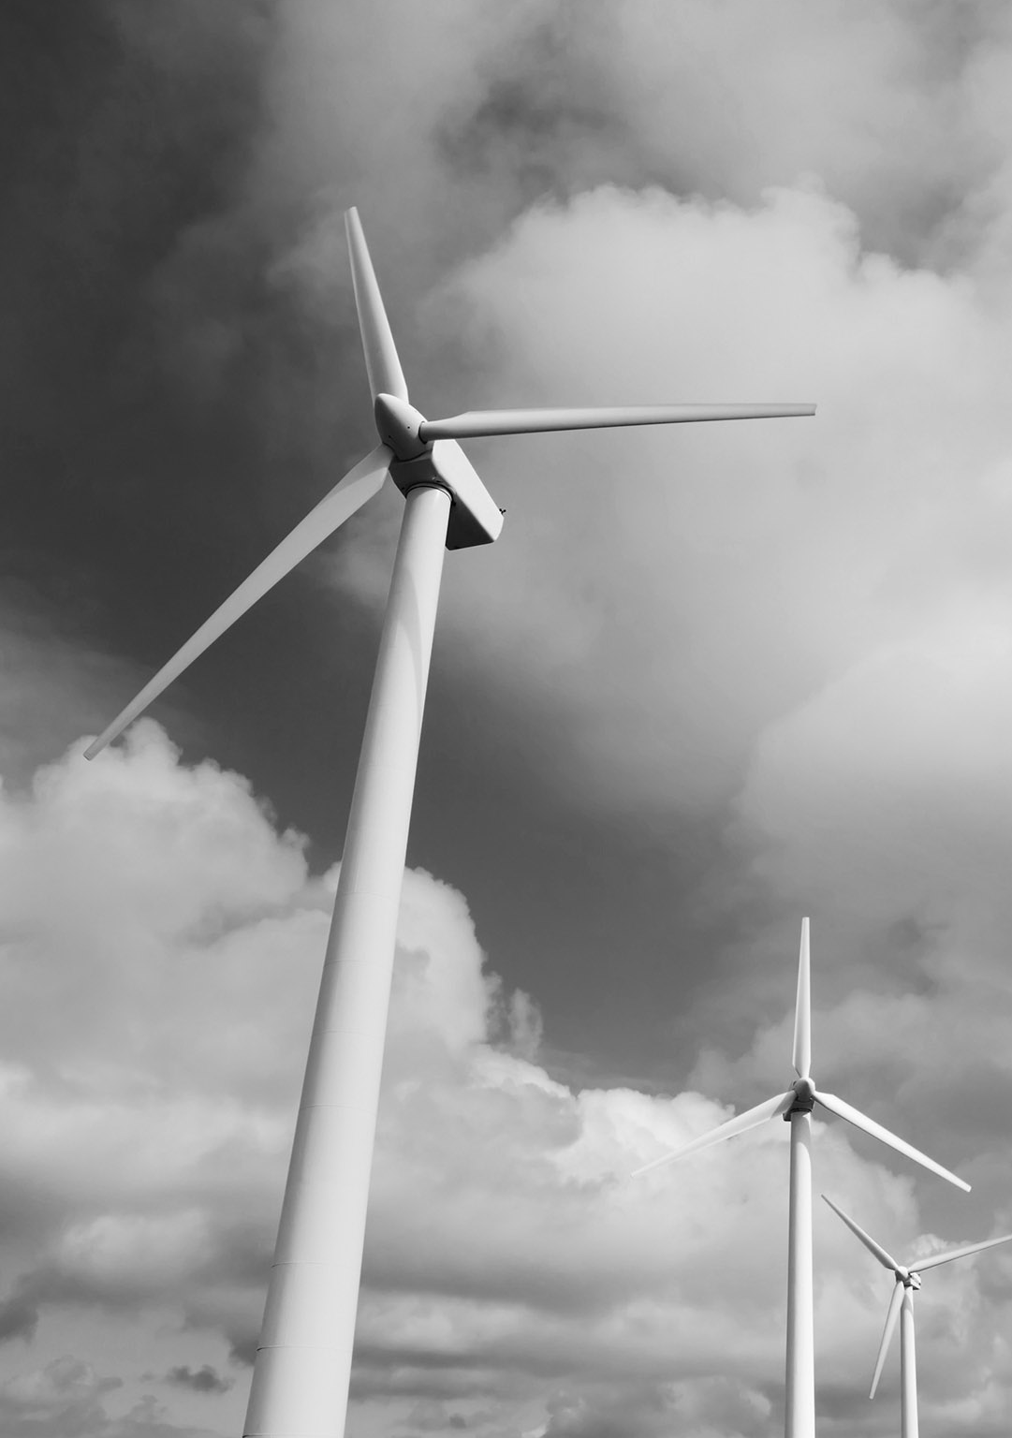
Text

